Slide 1
Planar separators
Qixin Zhu

Slide 2
Self-Dual Data Structure
R-division
MSSP
SSSP
Planar Separators
Max-flow
Level
Fundamental Cycle
Lipton-Tarjan
Miller's Simple Cycle
Naive O(N logN)
O(N logR)
O(N)
Dynamic Forest
Splay Tree
Dijkstra O(N logN)
O(N loglogN)
O(N)

Slide 3
Existing results
Fundamental Cycle is good enough
Holzer [2009]
Self-Dual Data Structure
R-division
Planar Separators
Level
Fundamental Cycle
Lipton-Tarjan
Miller's Simple Cycle
Simple Cycle is better
Fox-Epstein [2016]
Notes:
Fox-Epstein: FCS ok, root dependent, may be long
Simple Cycle has worst case guarantee
This proj: explicit dual graph data structure → can modify, not rely on pre-process: flattening, triangulation
FCS returns first non-tree edge → bad when root is randomly selected

Slide 4
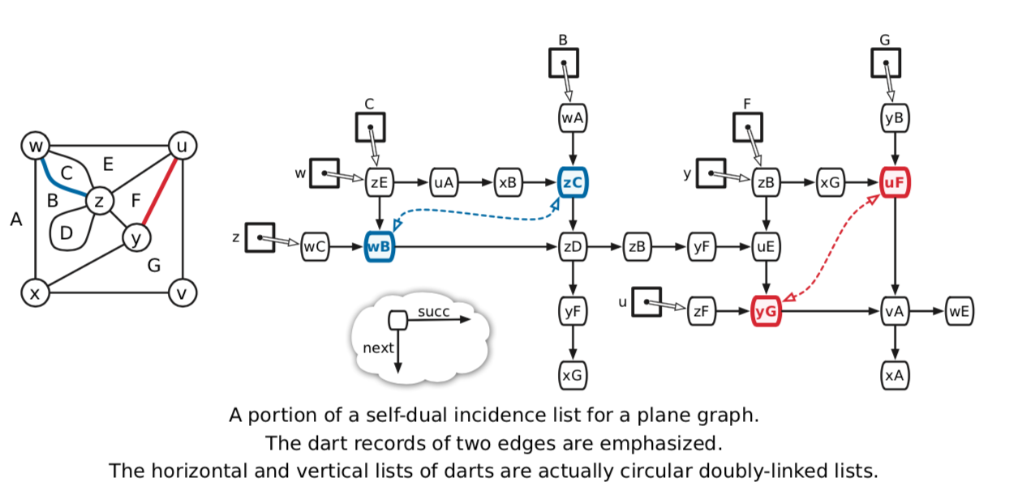
Self dual data structure
Notes:
Existing: half-edge data structure → used in meshing, FEM or graphic → assume valid mesh, don’t support operations
Holzer or Fox-epstein: no dual graph

Slide 5
Planar graph operations
Original G
Triangulated G
Flattened G

Slide 6
Primal – dual graph
Sample Graph
Grid Graph

Slide 7
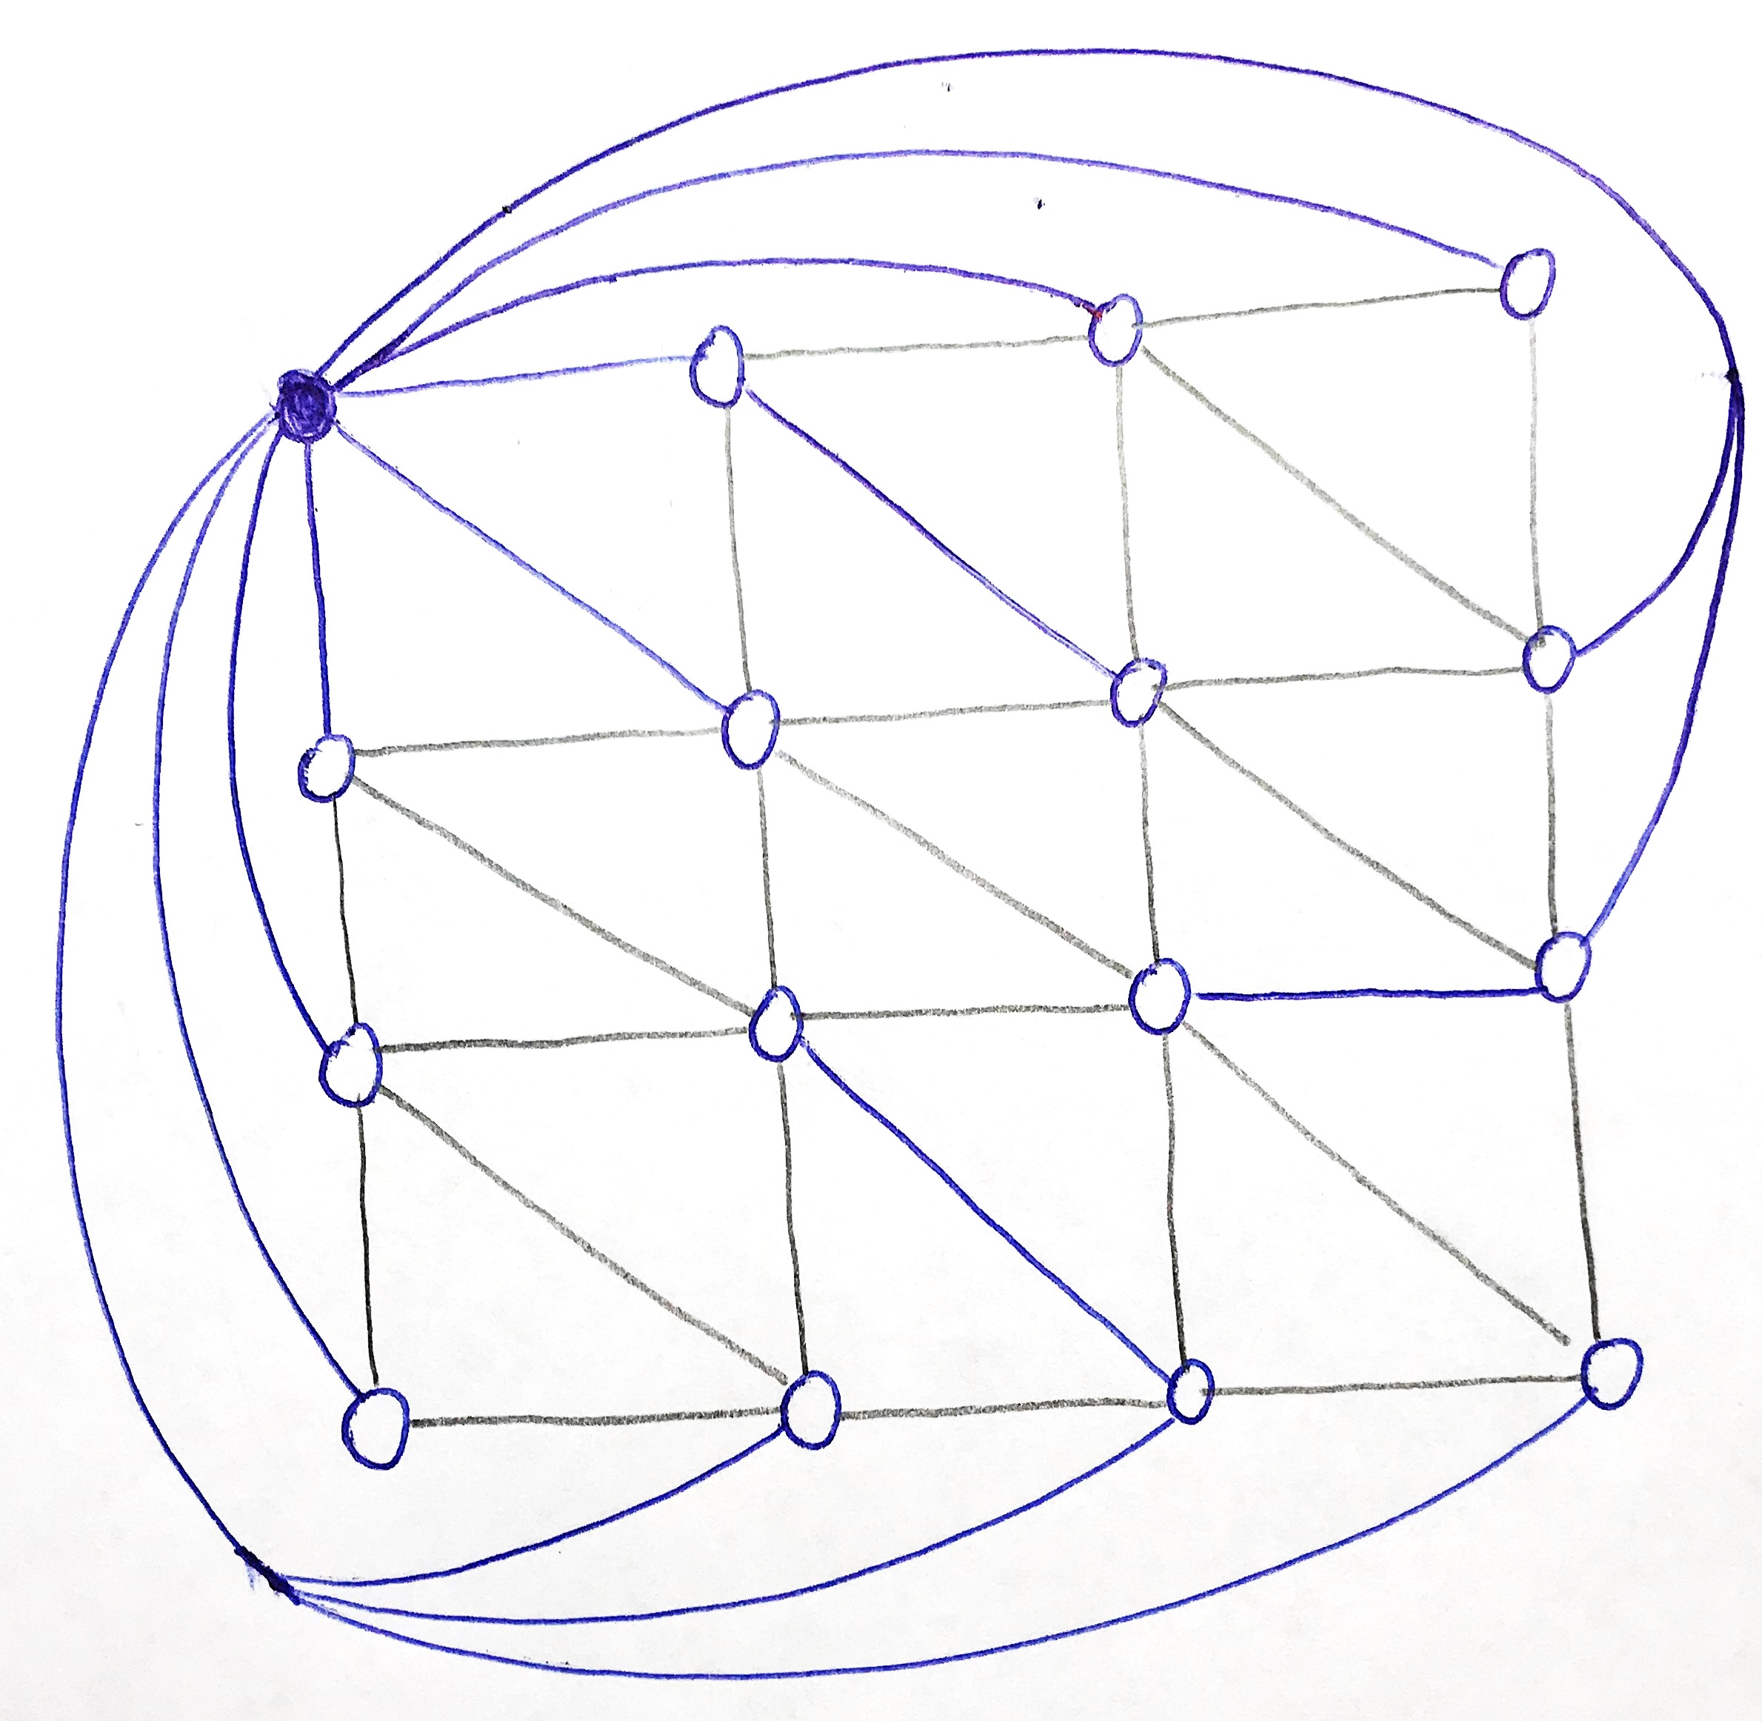
Level separator
Build BFS tree
Find median level

Slide 8
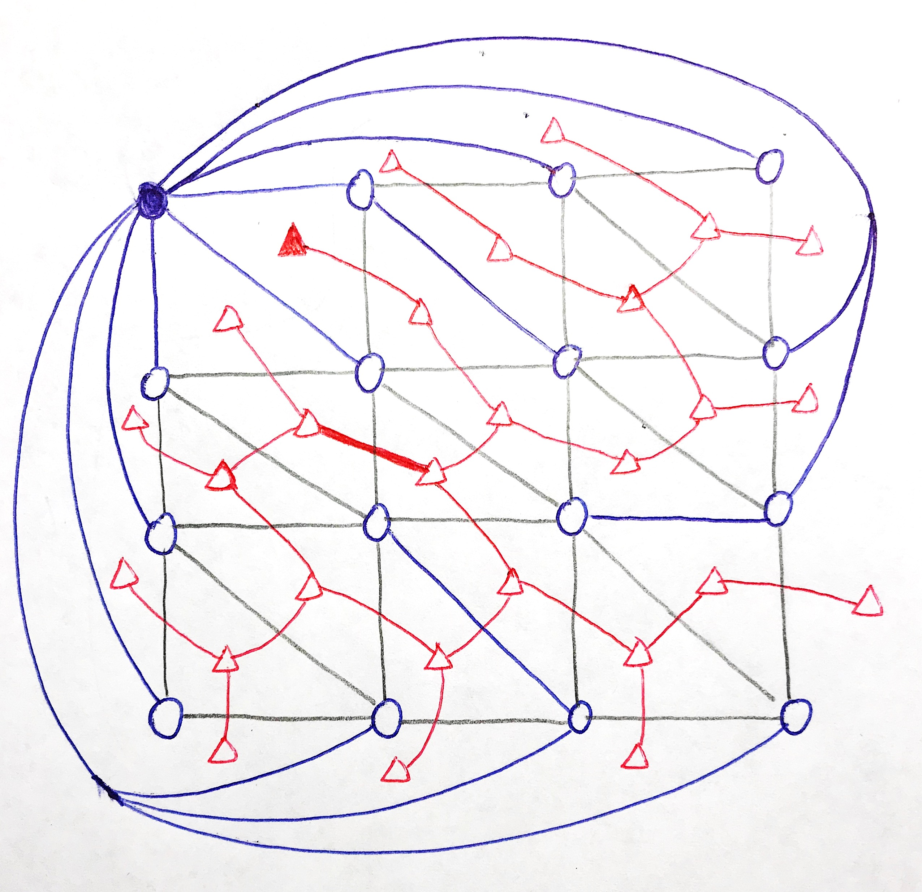
Fundamental cycle separator
Build primal BFS tree
Build dual tree (coTree)
Find edge separator in coTree
Form cycle with primal tree
Notes:
Holzer:
examine all non-tree edge, keep track of inside/outside
→ always find best (balance, smallest) fundamental cycle

Slide 9
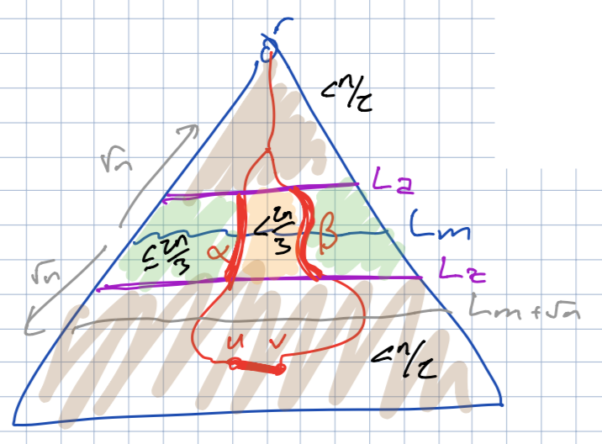
Lipton-tarjan separator
Build primal BFS tree
Find median level Lm
Find level La, Lz such that |L|≤√n
Shrink all vertices above La
Delete all vertices below Lz
Re-triangulate the modified graph
Find balanced fundamental cycle C
Organize 4 colored regions
Separator = C + La + Lz
Guarantee 4√n size

Slide 10
Performance evaluation
Separator Size
Number of separating vertices
Balance ratio
2 separator subgraphs including separating vertices
Runtime
2.9 GHz Intel Core i5
8GB RAM
Graph scale
10¹ ~ 10⁵ vertices
Random roots
32 trial
Average and StdDev
Notes:
Holzer:
“very large graph” ~ 10^4 < 500K vertices (stackoverflow)
Fox-Epstein:
max graph has 40 million vertices, good speed (need to study from it)

Slide 11
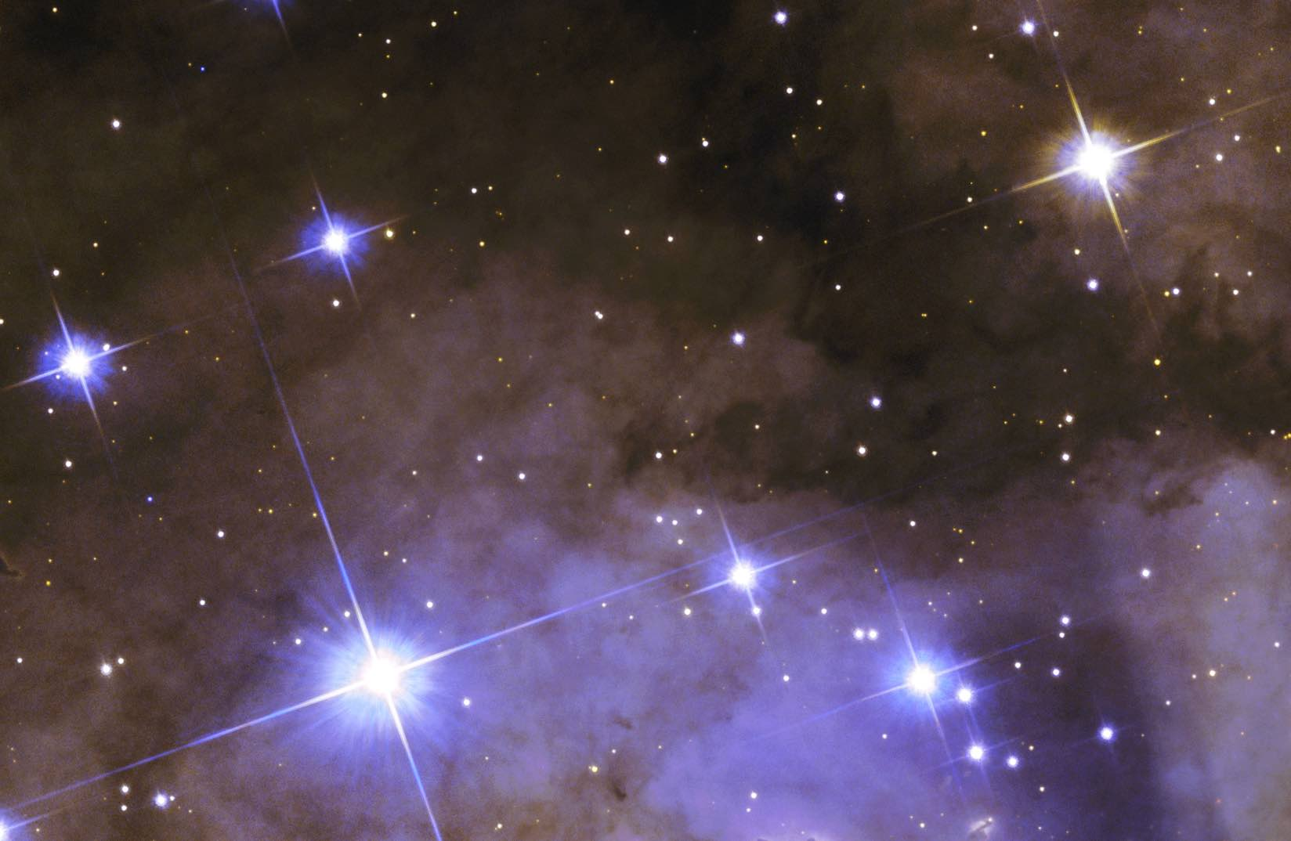
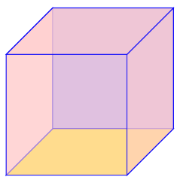
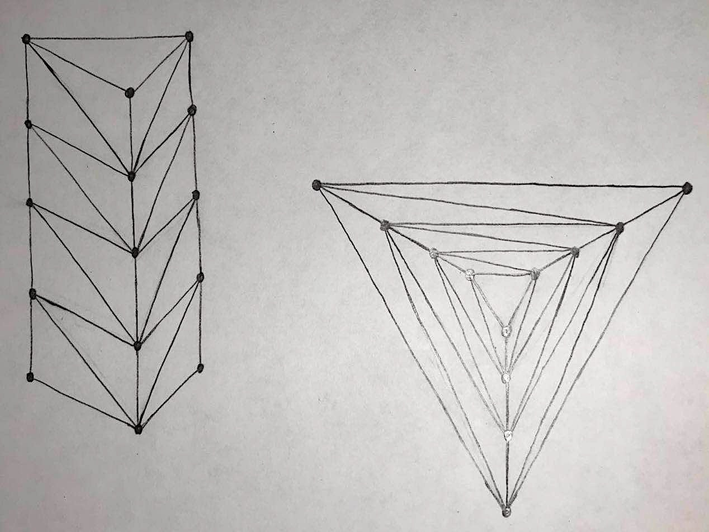
Planar graphs
Grids from photos
Photo source: NASA
Spheres from cube
Recursively add vertex to all faces of a cube
Cylinders
Very large diameter
Random triangle graphs
Add vertex to a random face

Slide 12
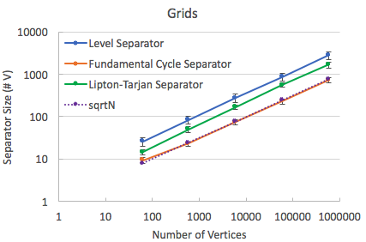
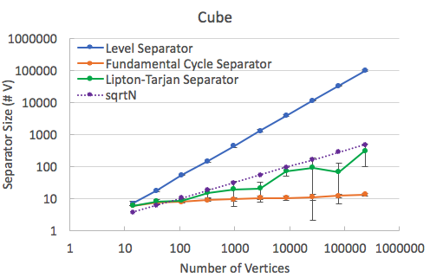
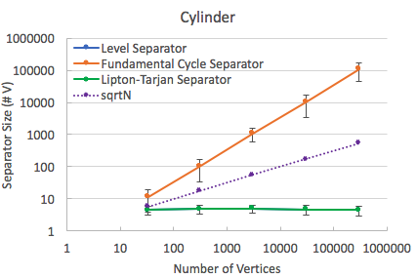
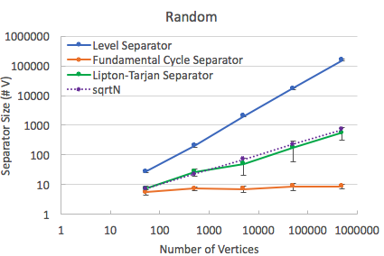
Separator size
Notes:
Difference of FCS:
Twice lucky in mine to find size 3 separator

Slide 13
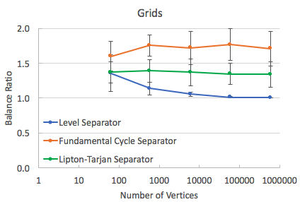
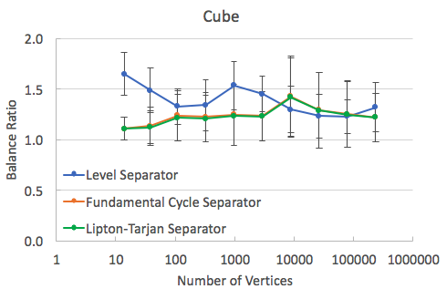
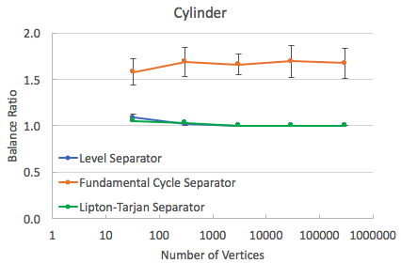
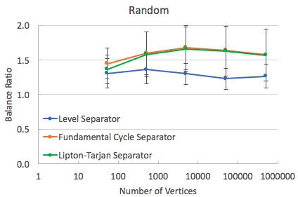
Balance ratio

Slide 14
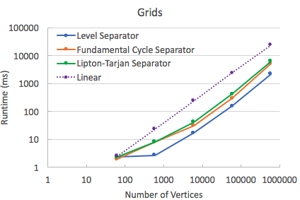
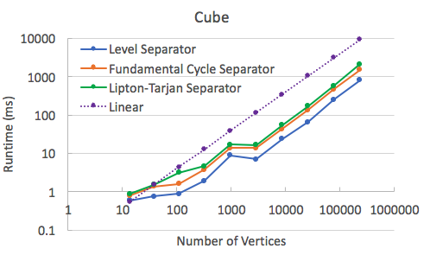
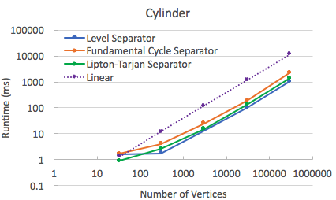
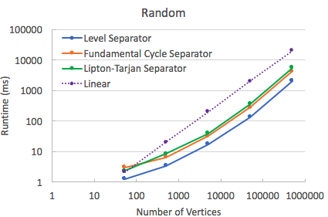
runtime

Slide 15
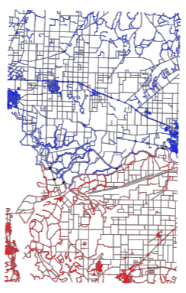
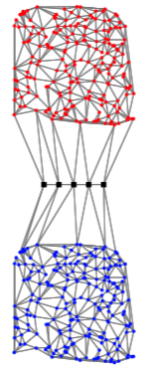
Future work
Test Graphs
Road Maps
Twins
FCS optimization
Lipton-Tarjan optimization
And of course
Miller’s Simple Cycle
R-division
MSSP
SSSP
Max-flow
……

Slide 16
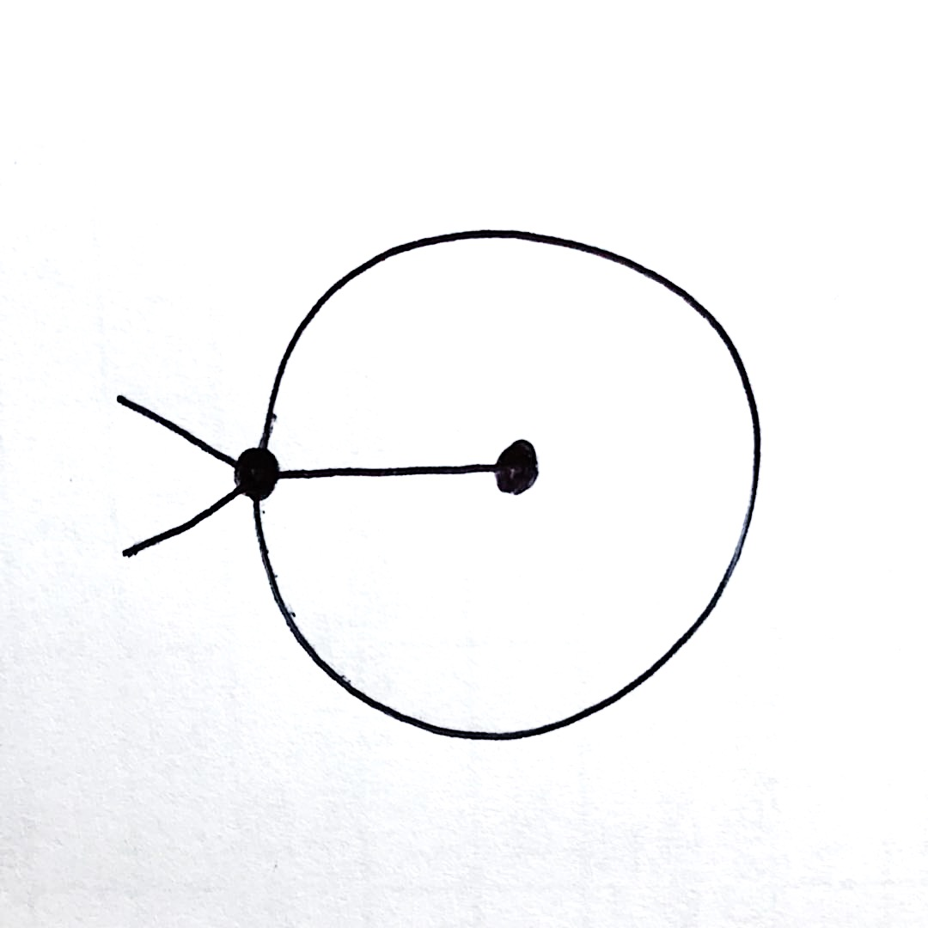
Questions & Suggestions?

Slide 17
References
Jeff’s notes
https://www.spacetelescope.org/images/heic1509a/
Lipton, Tarjan, A separator theorem for planar graphs, SIAM Journal on Applied Mathematics, 36 (2): 177–189, 1997
Martin Holzer, Frank Schulz, Dorothea Wagner, Grigorios Prasinos, and Christos D. Zaroliagis. 2009. Engineering planar separator algorithms. ACM Journal of Experimental Algorithmics 14 (2009), 5:1.5–5:1.31
Eli Fox-Epstein, Shay Mozes, Phitchaya Mangpo Phothilimthana, and Christian Sommer. 2016. Short and simple cycle separators in planar graphs. J. Exp. Algorithmics 21, 2, Article 2.2

